Slide 1

Python Stock Tracking Project
Miguel Angel Garces Lenis
CEIS150
DeVry University

Slide 2
INTRODUCTION
On the Python Stock Tracking Project that I am working on, I have constructed a menu that allows users to add and delete stocks, view graphs, import an Excel document that contains information about the stock, including earnings, volume, and a great deal more. A graphical user interface (GUI) that was made available made the use of this application simpler and more intuitive for any user.

Slide 3
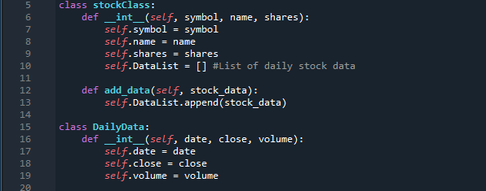
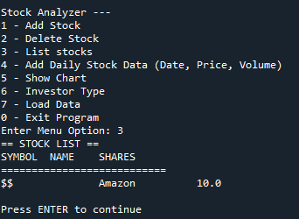
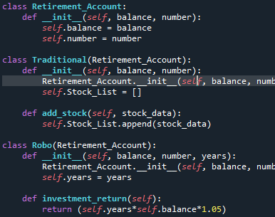
OBJECTIVES FOR EACH MODULE I
Module #1 (EASY)
Module #2 (MEDIUM)
Module #3 (HARD)
I worked on my project's initial class during the first module. The "stock class" project's goal was to develop two useful classes with properties that would save the user's input.
I created my first text-based user interface, which has helpful settings for the stock application. The first three features—adding a stock, listing all stocks, and daily data—were made available.
Because I started using inherited classes to make the option "Investor Type" available, Module #3 was more of a teaching module. After gathering user input, a program would be created specifically for the choice in order to make it available.

Slide 4
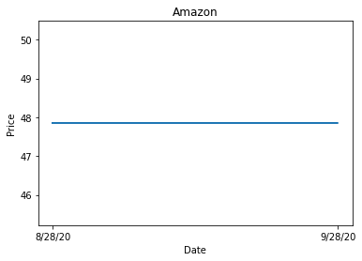
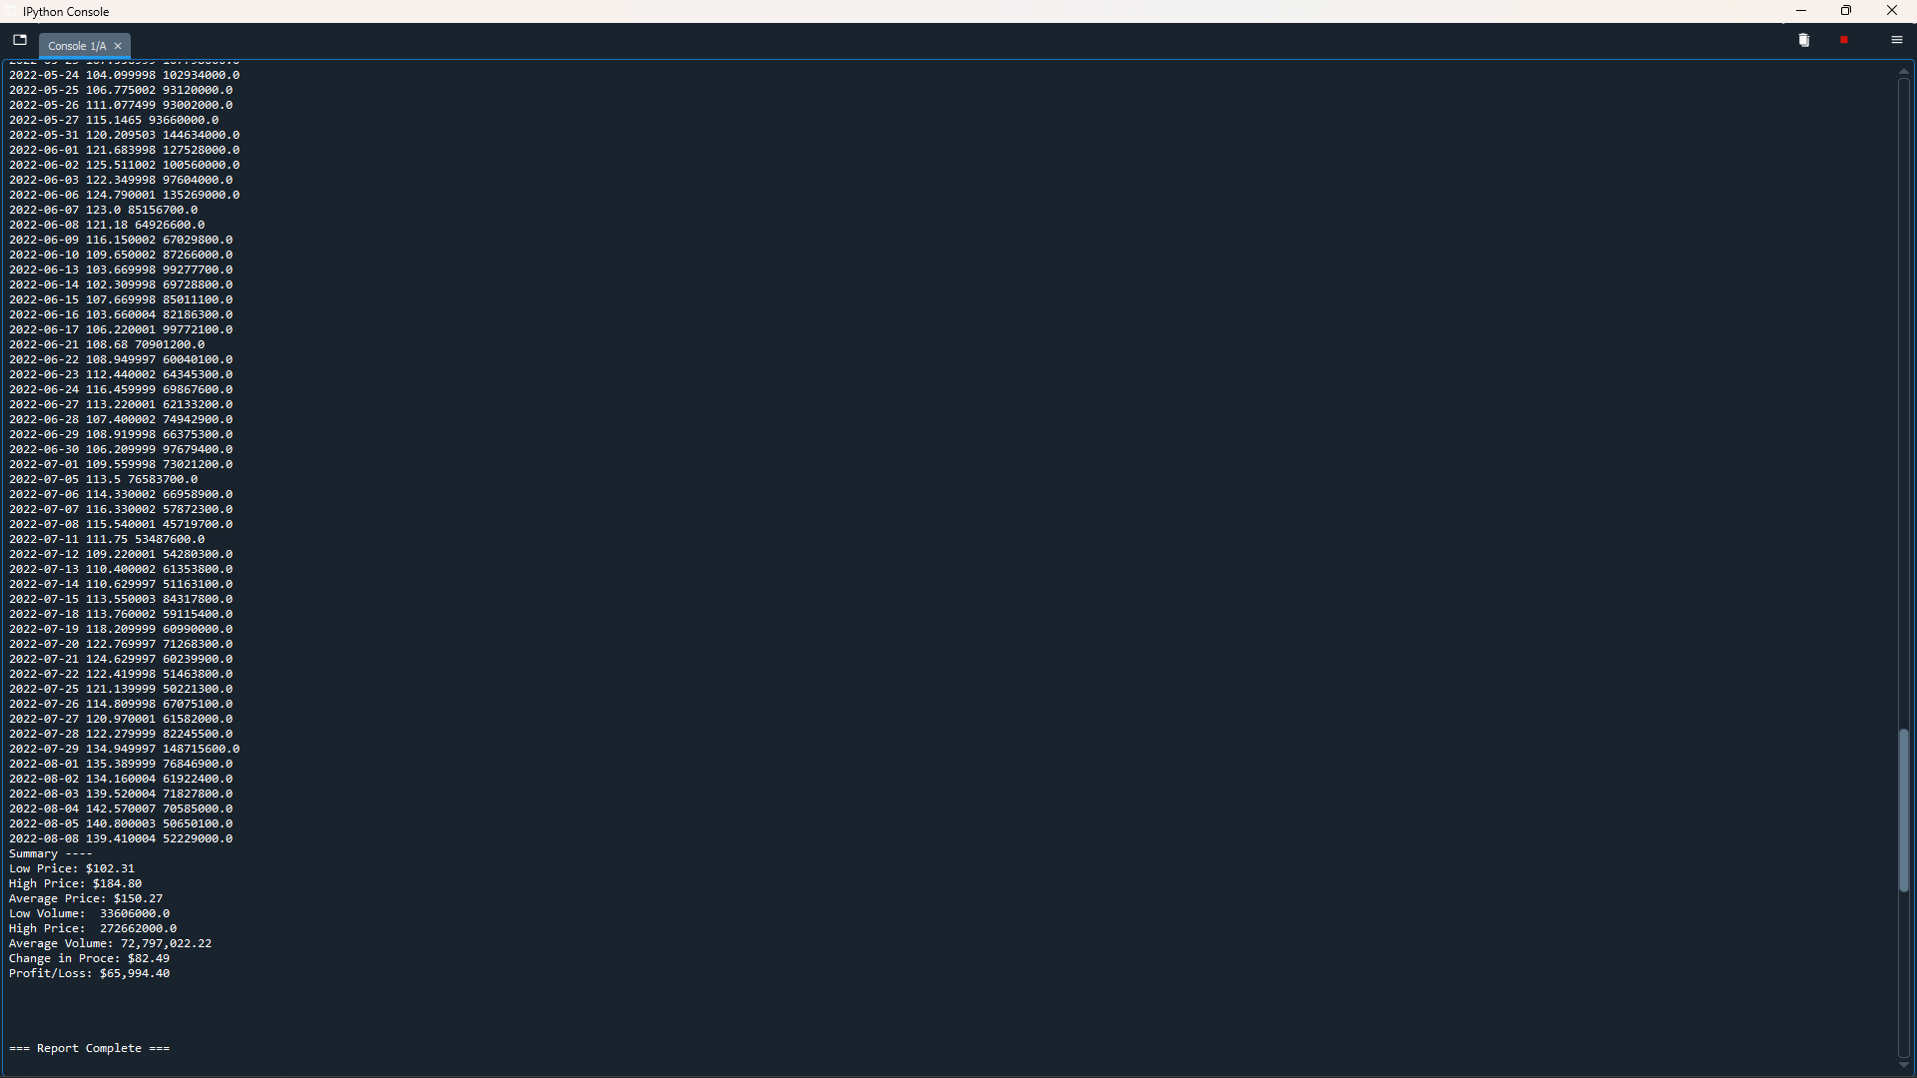
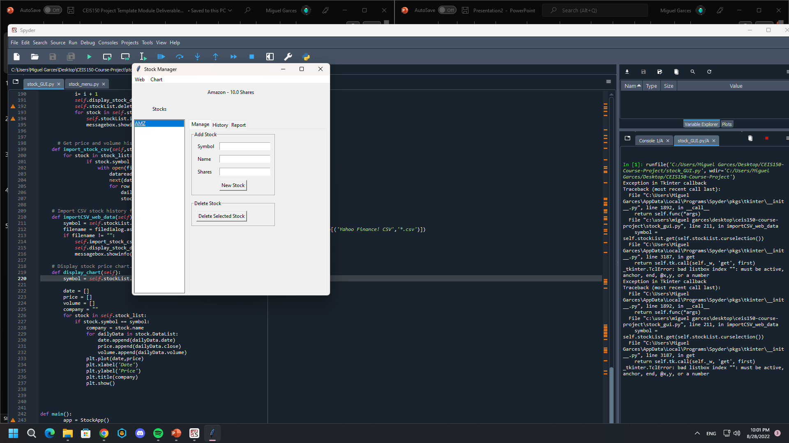
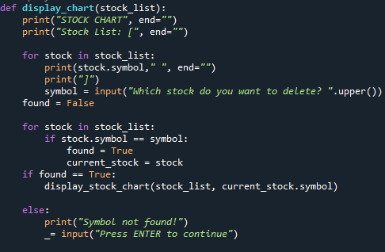
OBJECTIVES FOR EACH MODULE II
Module #4 (HARD)
Module #5 (MEDIUM)
Module #6 (HARDEST)
The "matplotlib" module was used in Module #4 to generate a chart that displays the price for each day (ups and downs). The data from "Daily Data" is required to display an accurate and precise chart.
On this project, data import is required. Using Yahoo Finance, I worked to collect stock data from a corporation and save it as an Excel document. Once the specific ".cvs" file has been entered, the data will display when a user selects the "Load Data" option.
Module #6 was focused on making a GUI which was provided by the professor. It uses Tkiner as a module and with its complex features, it will open a window with a better way to work on the stock application. It includes add and delete stocks, import data, and summary.

Slide 5
WHAT I LEARNED
Working on the Stock application allowed me to gain a lot of new programming abilities. For instance, I know how to design classes and utilize them on a single script, how to create a "Unit Test," how to create, edit, remove, and load data from a document (.txt and.cvs formats), and I also know a little bit about the Tkiner import. My ability to create a GUI on my own is still restricted, and there are some lines of code that I still need to learn more about. I learned a lot from working on this project, to sum it up.

Slide 6
CAREER SKILLS DEVELOPED
My future profession will benefit from all I learnt while developing the stock application, but I particularly valued and saw the value in using "Unit Testing." Unit tests are lines of code created to test specific scripts or program and show any potential issues. Knowing what is working and what isn't, as well as potential fixes, would be helpful. Making is enjoyable and beneficial!

Slide 7
CONCLUSION
My first significant project while attending DeVry University was the Stock Application Project, and I was able to learn a lot from it. I was unfamiliar with a lot of things, however the project made learning about classes, characteristics, conditions, imports and extract data, charts, and much more simple. Although a GUI was offered, it was still difficult to understand. I personally need to increase my knowledge of the Tkiner import and my ability to create a program's GUI.

Slide 8
THE END

